Slide 1

Respiratory and Heart Rate Monitor
Electronic Technologies and Biosensors Laboratory
Professor: Cerveri Pietro
Tutor: Marsilio Luca
Allegri Giorgio
Mazzucchelli Umberto
Pavirani Luca

Slide 2

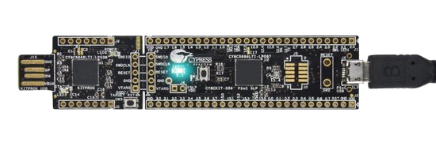
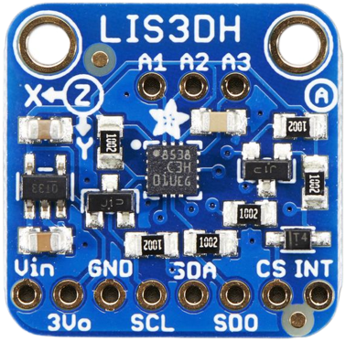
PROJECT AIM
Develop a simple Respiratory/Heart Rate Monitor, exploiting the PSoC and a 3-axis LIS3DH accelerometer.

Slide 3
TIMELINE
PSoC-accelerometer communication
Hardware setup
Data visualization
1
3
5
2
4
6
PSoC-GUI communication
HR & RR algorithm development
Data collection and statistical analysis

Slide 4
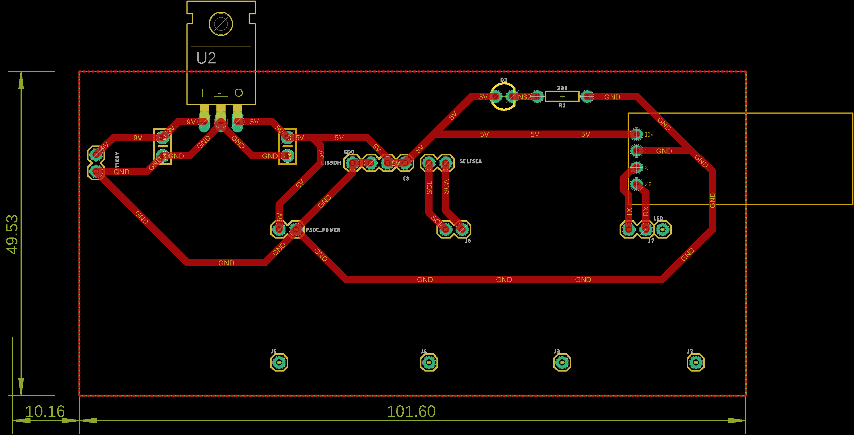
PCB
Voltage regulator
BT module
Accelerometer pins
Capacitors
PSoC power
Accelerometer I2C

Slide 5
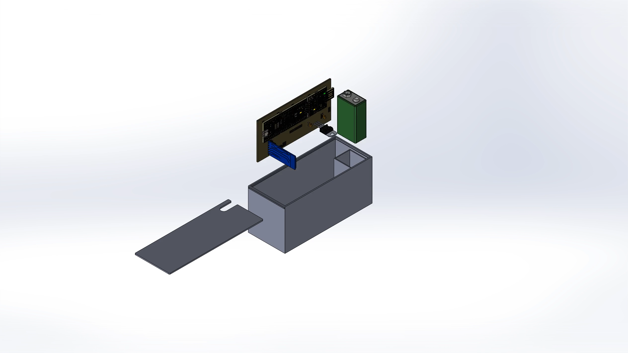
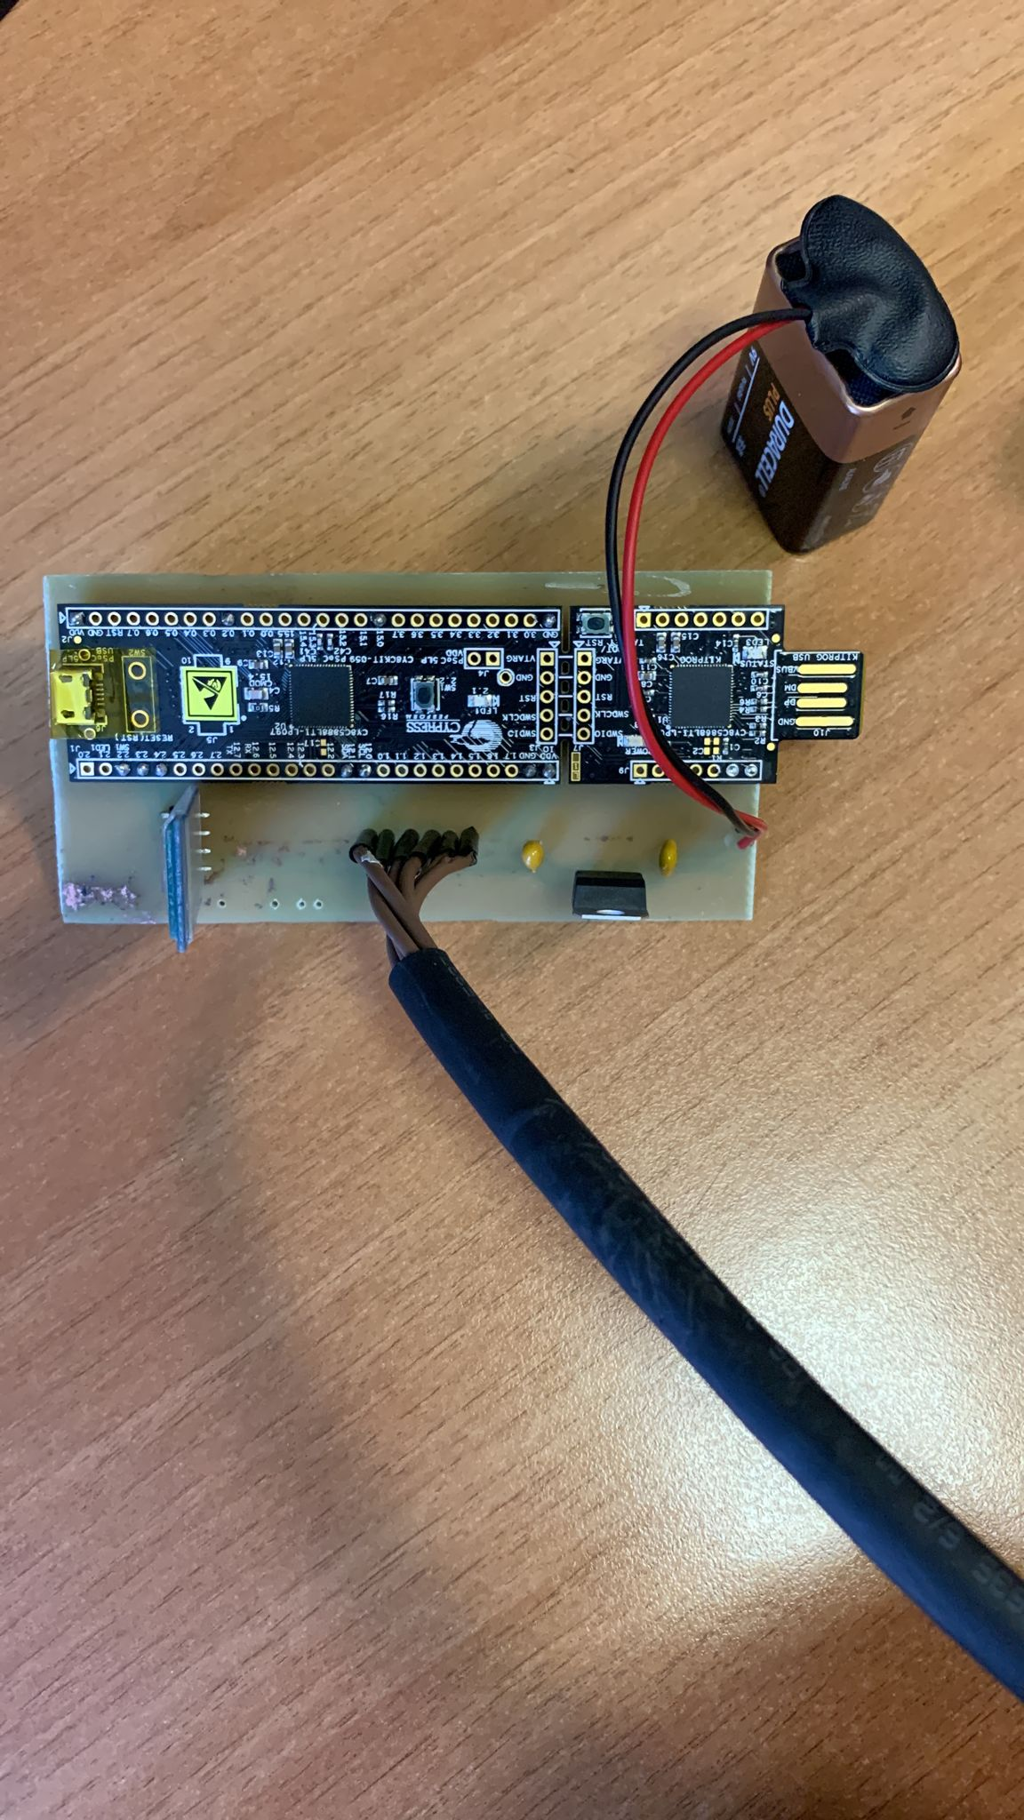
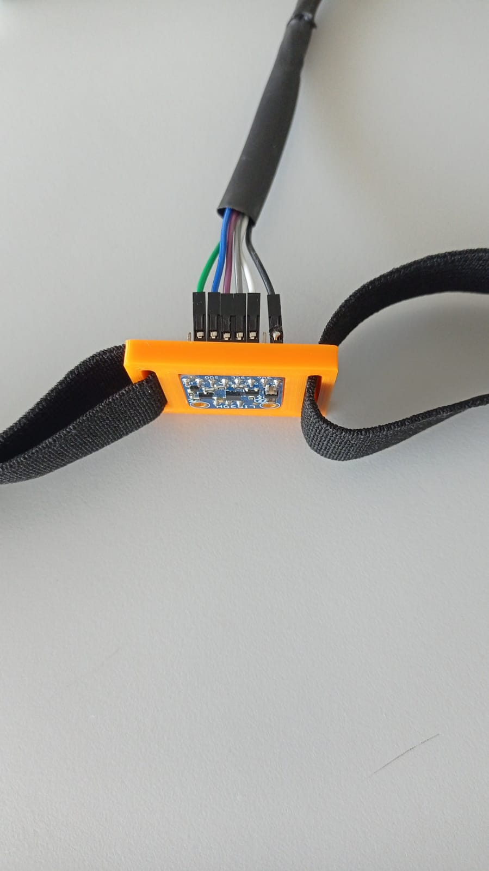
HARDWARE
Battery
Accelerometer pins
Capacitor
BT module
Voltage regulator

Slide 6
PSoC CODE
Start data acquisition
Read FIFO register status
no
Ovrn bit = 1?
yes
Read FIFO
Send data to GUI
Reset FIFO

Slide 7
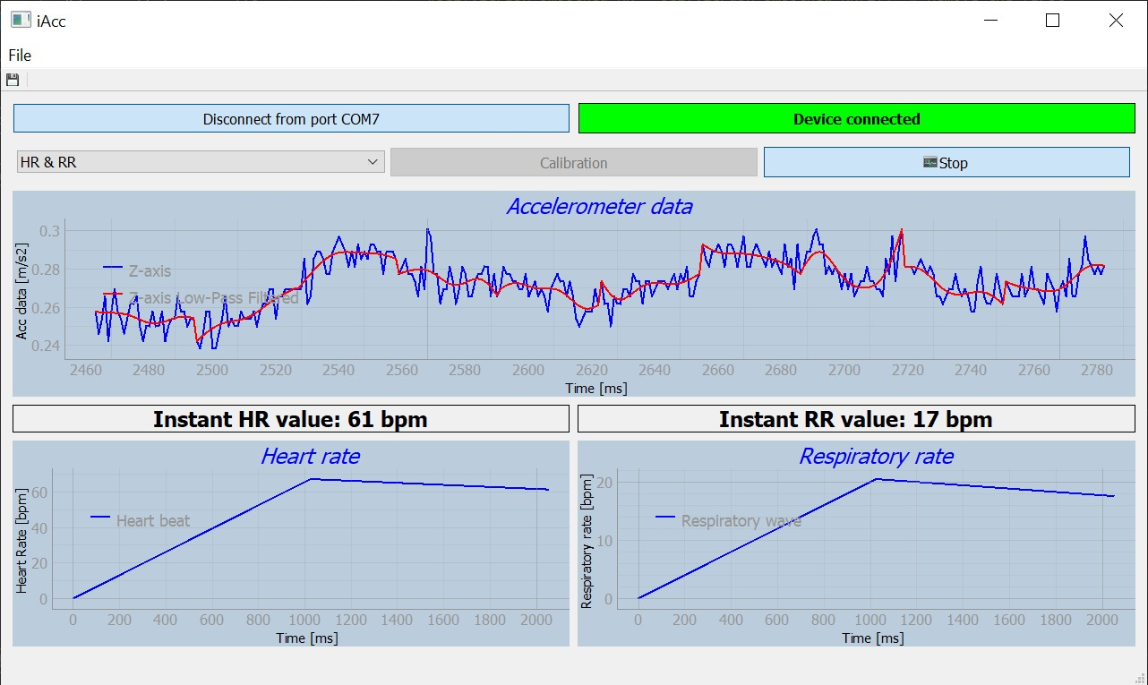
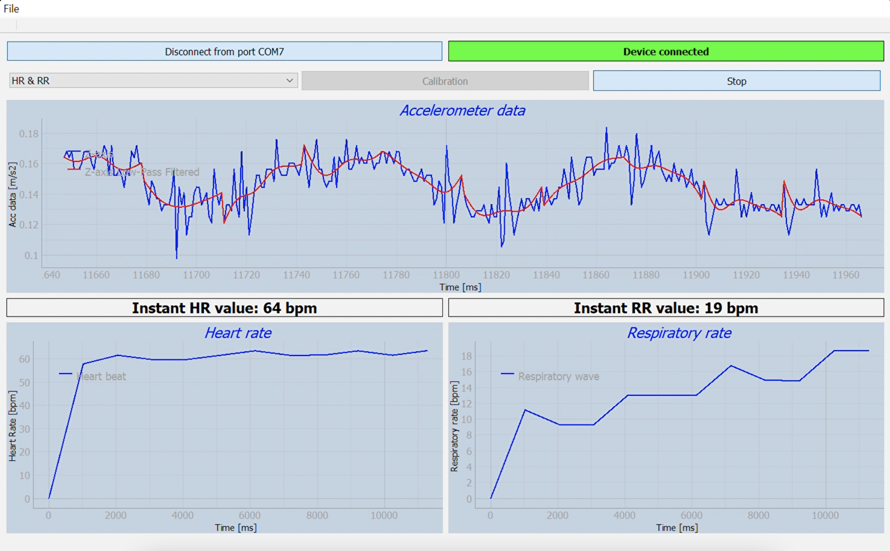
GUI
Automatic connection
Connection status
Export data
Start/stop
Mode selection
HR history
RR history

Slide 8
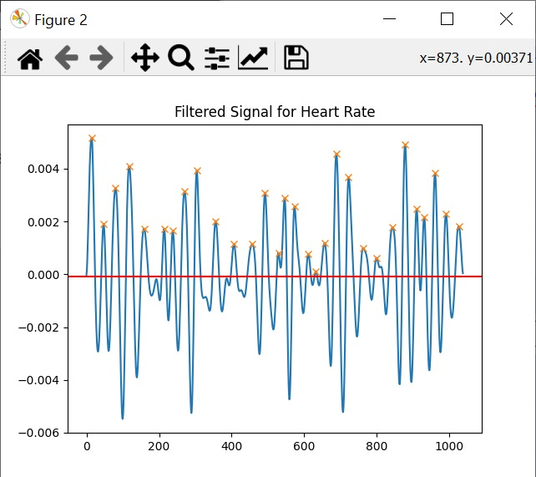
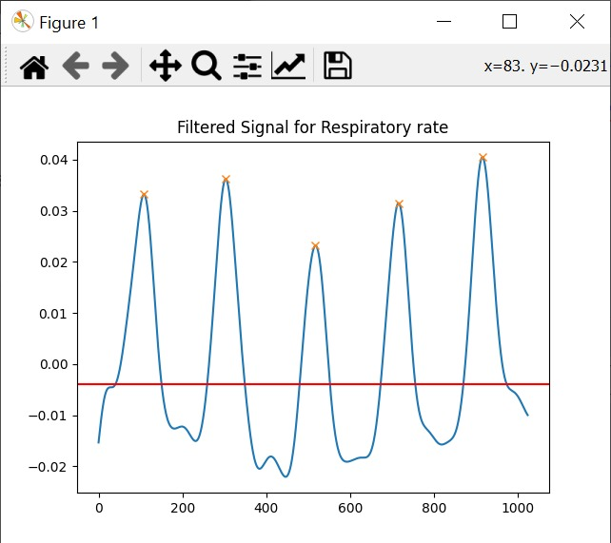
HR & RR
Acc data in digits
Data conversion in g
HR
RR
Band-pass
[1-5]Hz
Low-pass
[3 Hz, 5th order]
Detrend
Band-pass
[0.1-0.9]Hz
Savitzky-Golay smoothing [3th order, 15 samples]
Detrend
25 samples apart
50 samples apart
Moving average [25 samples]

Slide 9
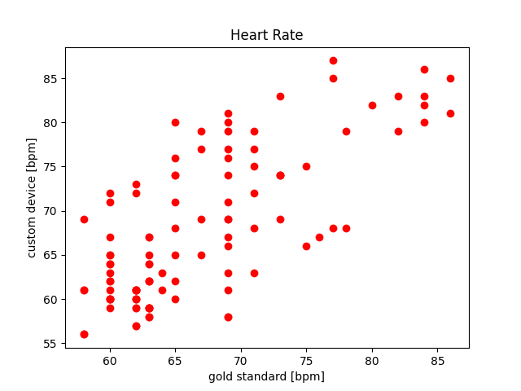
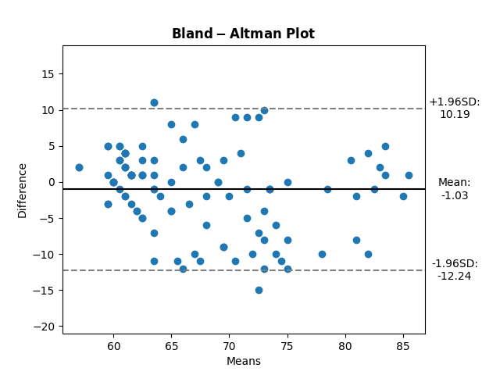
PERFORMANCE
HR
Vs. Garmin VivoSmart4
PCC = 0.74

Slide 10
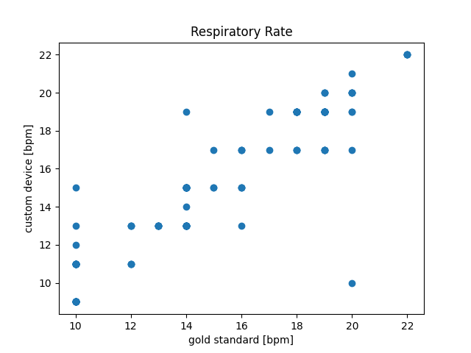
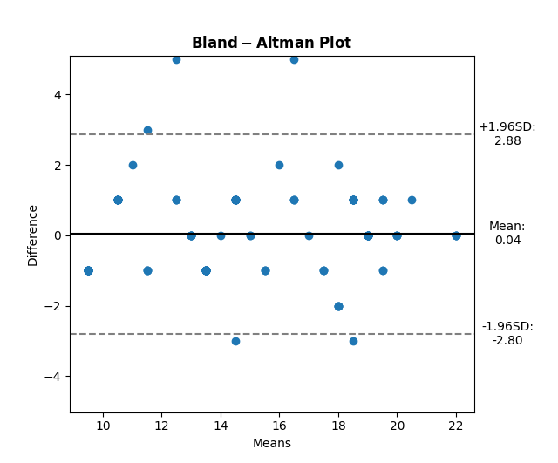
PERFORMANCE
RR
Vs. Metronome
PCC = 0.92

Slide 11
Goals and further developments
HR & RR detection and tracking
User interface
Data export
Increase signal robustness
Reduce battery consumption
Shielded cables
PCB optimization

Slide 12
Thank you for the attention

